Slide 1


Year 2 Reading Spine
Developed 2022

Slide 2











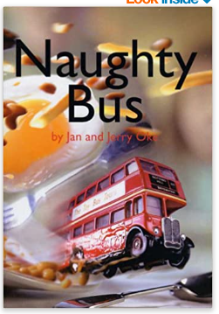
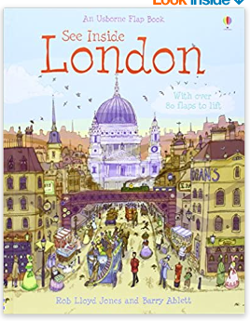
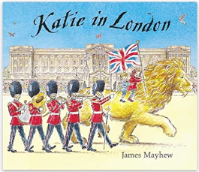
Year 2
Welcome to the UK
Focus Text
Non Linear time sequences
Complexity of the narrator
Focus Text
Focus Text

Slide 3

















Year 2
It’s a Wonderful World
Focus Text
Focus Text
Focus Text
Focus Text
Archaic Text
Resistant Text
Focus Text

Slide 4


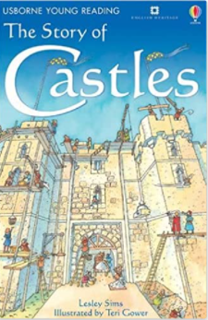

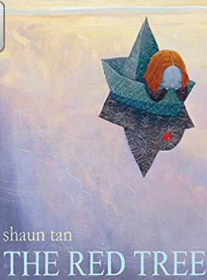

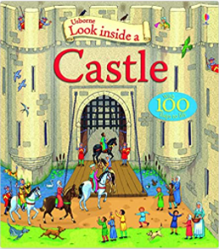






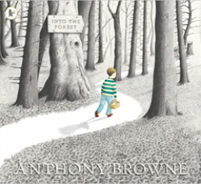
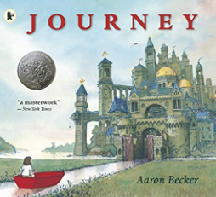
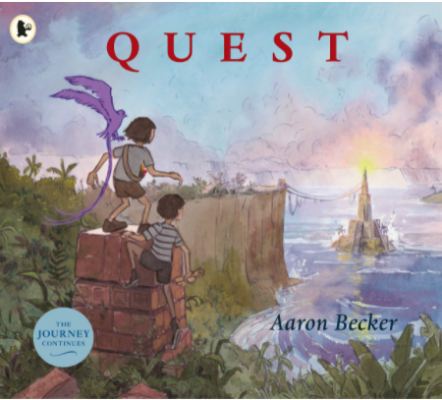
Year 2
Medieval Madness
Complexity of plot
Resistant Text
Focus Text
Focus Text
Archaic Text
Focus Text
Focus Text
Pie Corbett

Slide 5







Complexity of the narrator
Pie Corbett
Class Readers
Pie Corbett
Complexity of plot
Non Linear Time Sequences
Archaic Text
Pie Corbett

