Slide 1


Year 1 Reading Spine
Developed 2022

Slide 2














Year 1
Frozen World
Class Reader
Focus Text
Resistant Text
Focus Text

Slide 3





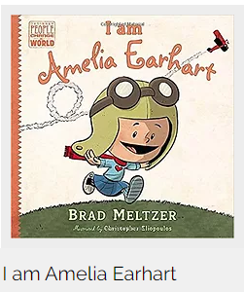
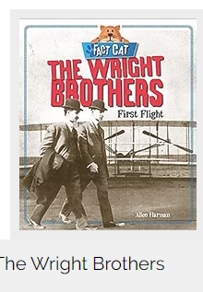

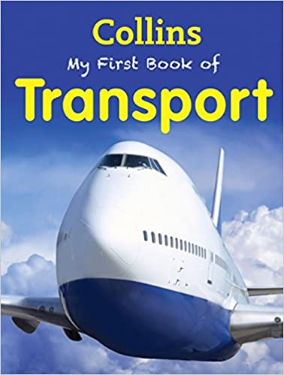





Year 1
All Aboard
Focus Text
Focus Text

Slide 4

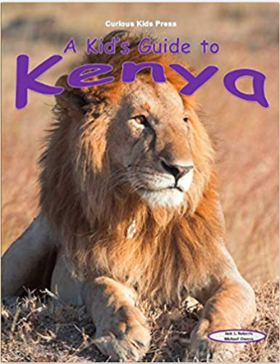










Year 1
Focus Text
Sensational Safari
Focus Text
Focus Text
Non linear time sequences

Slide 5














Year 1
Beside the seaside
Focus Text
Notes:
https://www.booksfortopics.com/seaside

Slide 6










Year 1
Bears
Focus Text
Complexity of the narrator
Focus Text

Slide 7
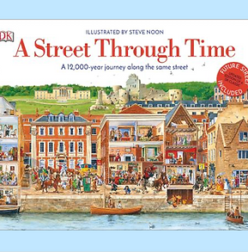


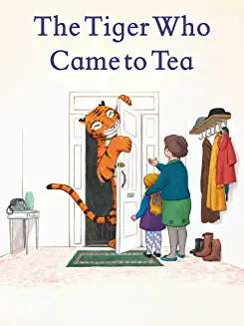









Year 1
Street Detectives
Complexity of the narrator
Complexity of the narrator
Complexity of plot
Focus Texts

Slide 8








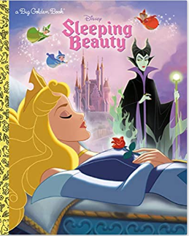
Aesop’s Fables
Archaic Texts
Archaic Text
Class Readers
Traditional Tales and Nursery Rhymes
Interwoven throughout all topics.
Archaic Texts
Resistant Text
Complexity of the narrator

